Slide 1
FORM VALIDATION
Form validation normally used to occur at the server, after the client had entered all the necessary data and then pressed the Submit button.
If the data entered by a client was incorrect or was simply missing, the server would have to send all the data back to the client and request that the form be resubmitted with correct information.

Slide 2
JavaScript provides a way to validate form's data on the client's computer before sending it to the web server. Form validation generally performs two functions.
Basic Validation − First of all, the form must be checked to make sure all the mandatory fields are filled in. It would require just a loop through each field in the form and check for data.
Data Format Validation − Secondly, the data that is entered must be checked for correct form and value. Your code must include appropriate logic to test correctness of data.

Slide 3
It is important to validate the form submitted by the user because it can have inappropriate values. So validation is must.
The JavaScript provides you the facility the validate the form on the client side so processing will be fast than server-side validation.
Through JavaScript, we can validate name, password, email, date, mobile number etc fields.

Slide 4
What validation checks in the form? It’s meant to check the following things:
Check for Empty Field: Has the user left required field empty. If it’s there, returns alert message.
Check for Numbers: User entered number in the text field where number is required, say in a Contact field.
Check for Alphabets: Has the user entered characters in alphabets, say in name field.
Check for Numbers and Letters: If a text input is all alphanumeric characters (numbers and letters), say in a message field
Check for Characters: Has the user entered correct number of characters. (Useful when restricting the length of a username and/or password)
Select for Drop Down List Item: If a selection has been made from HTML select input (the drop down selector)
Email Validation: has the user entered valid email address.

Slide 5
Form Validation Example
<script>
function validateform(){
var name=document.myform.name.value;
var password=document.myform.password.value;
if (name==null || name==""){
alert("Name can't be blank");
return false;
}else if(password.length<6){
alert("Password must be at least 6 characters long.");
return false;
}
}
</script>
<body>
<form name="myform" method="post" action="abc.jsp" onsubmit="return validateform()" >
Name: <input type="text" name="name"><br/>
Password: <input type="password" name="password"><br/>
<input type="submit" value="register">
</form>

Slide 6
Retype Password Validation
<script type="text/javascript">
function matchpass(){
var firstpassword=document.f1.password.value;
var secondpassword=document.f1.password2.value;
if(firstpassword==secondpassword){
return true;
}
else{
alert("password must be same!");
return false;
}
}
</script>
<form name="f1" action="register.jsp" onsubmit="return matchpass()">
Password:<input type="password" name="password" /><br/>
Re-enter Password:<input type="password" name="password2"/><br/>
<input type="submit">
</form>

Slide 7
Number Validation
<script>
function validate(){
var num=document.myform.num.value;
if (isNaN(num)){
document.getElementById("numloc").innerHTML="Enter Numeric value only";
return false;
}else{
return true;
}
}
</script>
<form name="myform" onsubmit="return validate()" >
Number: <input type="text" name="num"><span id="numloc"></span><br/>
<input type="submit" value="submit">
</form>

Slide 8
Regular Expression
Regular expression helps you in pattern matching in string.
. : Matches any single charcter except a new line
+ : Matches the preceding character or repeated character.
$ : Matches character at the end of the line.
.: Matches only period.
^ : Matches the beginning of a line or string.
: Escapes a special character.
- : Range indicator. [a-z, A-Z]
-: Escapes a special character.(e.g. escaping - by -)

Slide 9
[0-9] : It matches digital number from 0-9.
[a-z] : It matches characters from lowercase ‘a’ to lowercase ‘z’.
[A-Z] : It matches characters from uppercase ‘A’ to lowercase ‘Z’.
w: Matches a word character and underscore. (a-z, A-Z, 0-9, _).
W: Matches a non word character (%, #, @, !).
{M, N} : Donates minimum M and maximum N value.

Slide 10
Checking for all Letters
There is an expression that checks whether the string contains only alphabets or not. The expression is: /^[a-zA-Z]+$/ The above expression checks whether the input characters in the string is alphabet or not. If the entered characters in the field is not in lower case or upper case. It will return a false value.
function inputAlphabet(inputtext, alertMsg)
{
var alphaExp = /^[a-zA-Z]+$/;
if(inputtext.value.match(alphaExp))
{
return true;
}
else
{
document.getElementById('p1').innerText = alertMsg; inputtext.focus();
return false;
}
}

Slide 11
Checking for all numbers
When it’s about checking contact field or zip code field, one need to check whether only the number have been entered or not. The basic expression for matching entered value as number in the field is: /^[0-9]+$/. If the string value is numeric, it will return true, otherwise it will return false.
//This segment displays the validation rule for zip code field.
function textNumeric(inputtext, alertMsg){
var numericExpression = /^[0-9]+$/;
if(inputtext.value.match(numericExpression)){
return true;
}else{
document.getElementById('p6').innerText = alertMsg;
inputtext.focus();
return false;
}
}

Slide 12
Checking for all numbers and letters
By combining the expression for numbers and alphabetic characters, there is an expression that checks, whether the entered things includes numbers and alphabetic character or not. The expression for matching numbers and characters in the field is: /^[0-9a-zA-Z]+$/
//This segment displays the validation rule for address field.
function textAlphanumeric(inputtext, alertMsg){
var alphaExp = /^[0-9a-zA-Z]+$/;
if(inputtext.value.match(alphaExp)){
return true;
}else{
document.getElementById('p5').innerText = alertMsg;
inputtext.focus();
return false;
}
}

Slide 13
Restricting the length
If you want to restrict the number of characters, the user enters into the field, than it’s better to restrict the length of the field.
//This segment displays the validation rule for username.
function lengthDefine(inputtext, min, max){
var uInput = inputtext.value;
if(uInput.length >= min && uInput.length <= max){
return true;
}else{
document.getElementById('p2').innerText = "* Please enter between " +min+ " and " +max+ " characters *";
inputtext.focus();
return false;
}
}

Slide 14
Right Selection made from drop-down
It’s must to provide validation in the select field. It happens sometimes, when user forgets to choose option from the select feild. In that case, the form should convey about issue so that user can take the action.
//This segment displays the validation rule for selection field.
function trueSelection(inputtext, alertMsg){
if(inputtext.value == "Please Choose"){
document.getElementById('p4').innerText = alertMsg;
inputtext.focus();
return false;
}else{
return true;
}
}

Slide 15
Email Validation
Firstly, let’s have a look how a user can make mistake while entering wrong email address:
@compem.net [no character before@]
Lime!gear@demon.com [invalid character!]
sunshine@mode_bright.com [underscore are not allowed in the domain name]
Now let’s see what a valid email address should contain:
The combination of letters, numbers, periods, plus sign, and /or underscores.
The @symbol.
Combination of letters, numbers and periods.
The top level domain. (com, net, org, us, gov)

Slide 16
A general expression to check valid email address is: /^[w-.+]+@[a-zA-Z0-9.]+.[a-zA-Z0-9]{2,4}$/ The expression checks the letters, numbers, and other symbol at a proper sequence. The sequence is defined as: [alphabets/numbers/underscore/plus sign-@-alphabets/numbers/periods.domain name] If the entered email address is not in a proper sequence, then the message will popup which says “Wrong Email Address”.
//This segment displays the validation rule for E-mail.
function emailValidation(inputtext, alertMsg){
var emailExp = /^[w-.+]+@[a-zA-Z0-9.-]+.[a-zA-z0-9]{2,4}$/;
if(inputtext.value.match(emailExp)){
return true;
}else{
document.getElementById('p3').innerText = alertMsg;
inputtext.focus();
return false;
}
}

Slide 17
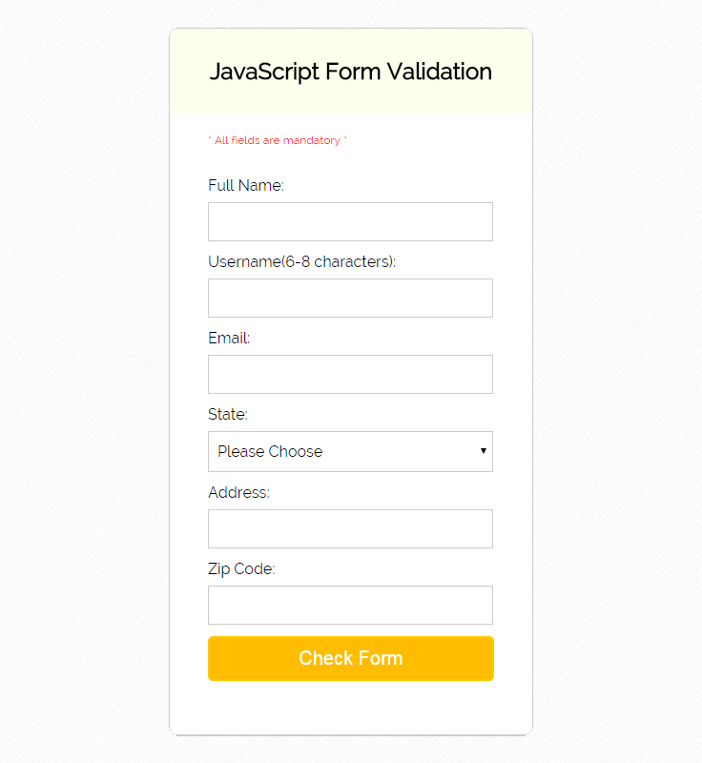

Slide 18
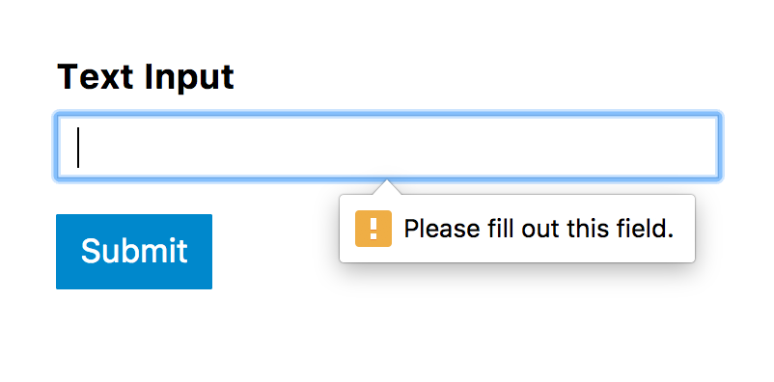
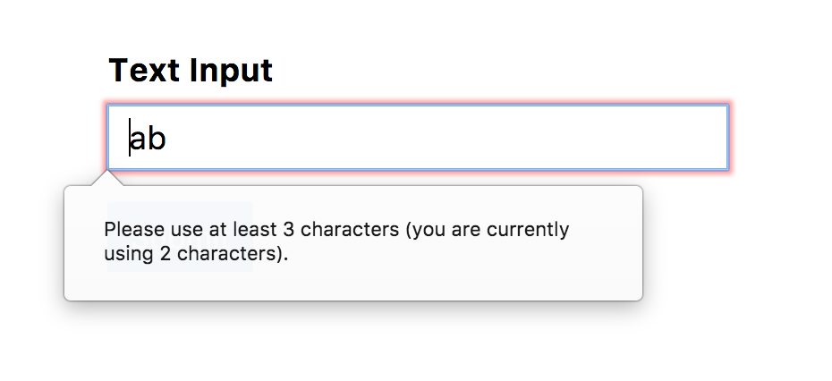
Basic Text Validation
<input type="text" required>
<input type="text" minlength="3" maxlength="12">

Slide 19
Password Validation
<input type="password" pattern="^(?=.*\d)(?=.*[a-z])(?=.*[A-Z])(?!.*\s).*$" required>
<input type="password" pattern="^(?=.*\d)(?=.*[a-z])(?=.*[A-Z])(?!.*\s).*$“
title="Please include at least 1 uppercase character, 1 lowercase character, and 1 number." required>
<input type="password" minlength="8" pattern="^(?=.*\d)(?=.*[a-z])(?=.*[A-Z])(?!.*\s).*$"
title="Please include at least 1 uppercase character, 1 lowercase character, and 1 number." required>

Slide 20
Validating a number:
<input type="number" pattern="[-+]?[0-9]">
<input type="number" step="any" pattern="[-+]?[0-9]*[.,]?[0-9]+">
<input type="number" min="3" max="42" pattern="[3-9]|[1-3][0-9]|4[0-2]">

Slide 21
Validating Date
<input type="date" pattern="(?:19|20)[0-9]{2}-(?:(?:0[1-9]|1[0-2])-(?:0[1-9]|1[0-9]|2[0-9])|(?:(?!02)(?:0[1-9]|1[0-2])-(?:30))|(?:(?:0[13578]|1[02])-31))">
<input type="time" pattern="(0[0-9]|1[0-9]|2[0-3])(:[0-5][0-9])">
<input type="month" pattern="(?:19|20)[0-9]{2}-(?:(?:0[1-9]|1[0-2]))">

